Slide 1

DevOps Introduction Basic Concepts
Title: Overview of DevOps
beCloudReady

Slide 2
Agenda
Overview of DevOps
Goal of DevOps
Evolution of DevOps

Slide 3
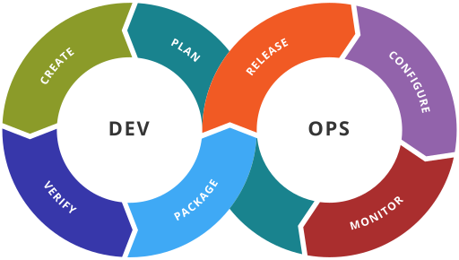
DevOps

Slide 4
Goals of DevOps
It’s a philosophy
Reduce Organization silos
Accept failures, and act on them
Implement gradual changes
Tooling and Automation

Slide 5
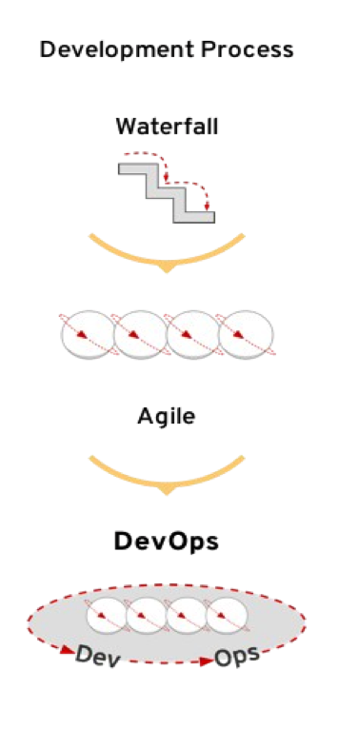
Driving force for DevOps – Software Delivery/Development
Dramatic Changes in software delivery mode
Fast paced development and Agile based SDLC
Small and incremental changes and rapid deployment
Software release cycle changed from yearly to weekly!
Tremendous pressure on deployment pipeline
Lead to end to end automation of delivery pipeline.

Slide 6
SDLC – WATERFALL ( SIMPLIFIED )
Requirement
Analysis
Requirements are gathered
Design
Architecture design is conceptualized
Development
Actual development work is done
Testing and deploymen
Testing and bug fixes are done

Slide 7
Agile based SDLC ( Simplified )
Incremental requirements ( whole requirement is not clear)
Deployment ( Continuous delivery )
Design ( feedback based system to help evolve the requirement)
Testing ( Continuous Testing )
Development ( small requirement == small development )

Slide 8
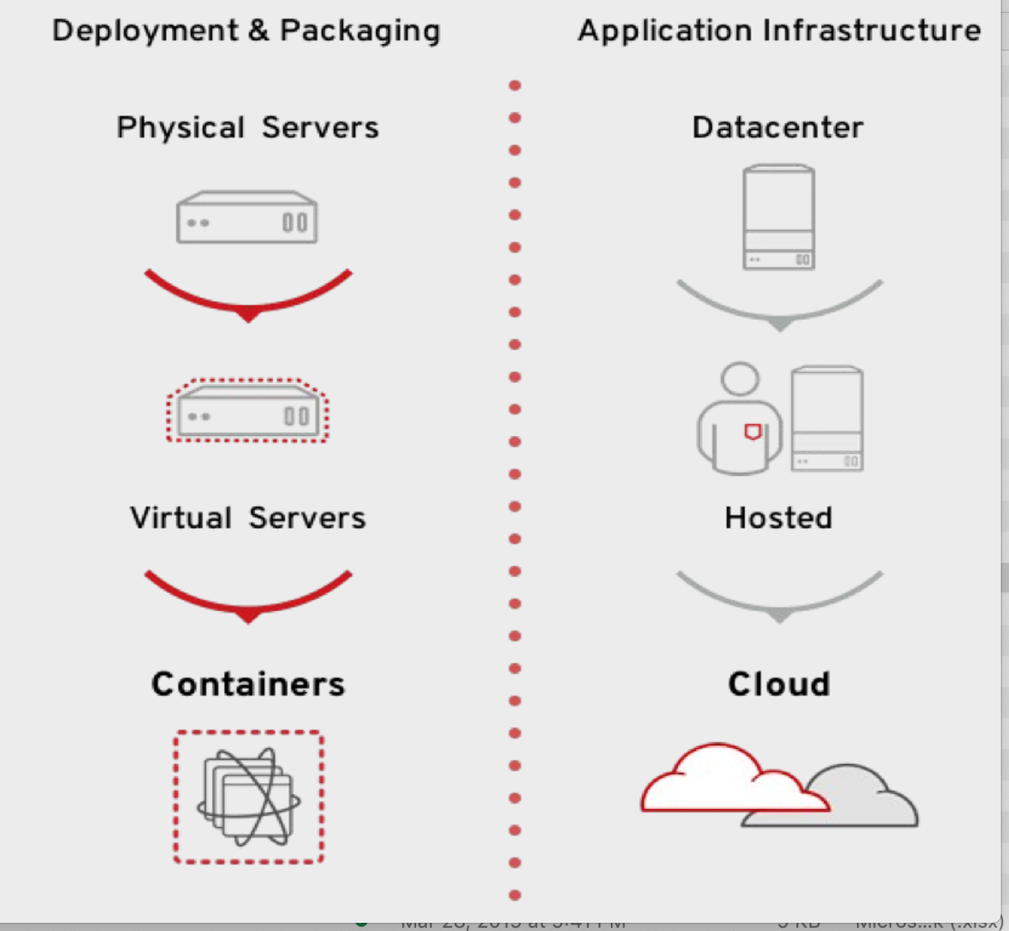
Driving force for DevOps - Infrastructure
Rising Data center complexity
From single server to large number of containers.
From regular data center to complex Hybride Cloud ( Private + Public )

Slide 9

Components DevOps
Configuration Management
System Administration
Build Engineering
Test Automation
Production Deployment
Monitoring and Alert
Replace him/her self

Slide 10
DevOps ( Development Operations )
Linux Admin
Configuration Manager
Build Engineer
Developer
Test Automation
Platform Operation Orchestration

Slide 11
Configuration Management
Tools help to automate repetitive work done be System Admins
Helps to keep consistent and traceable configuration changes at OS level
Write once, use multiple times approach
Removes person dependency and make operation process dependent.

Slide 12
Puppet Vs Ansible Vs Salt Vs Chef comparison
Functionality | Ansible | Puppet | Salt | Chef
Language | YAML | DSL/Ruby based(Puppet Language) | YML, Python | DSL Ruby
Design Goal | Simple Client less solution. | Comprehensive Configuration Management Solution | High Performance, Scalable solution. | High Scalable and performance
GUI | Ansible Tower [Paid] | Puppet Master GUI [Paid/Free] | Salt Master GUI [Paid/Free] | Chef GUI[Paid/Free]
Design Architecture | Server Push model via SSH | Client Server model | Client Server, Push mode, client-client | Client Server,
Client/Agent Instance | No Agent required [default Linux SSH client] | Ruby + Puppet Agent | Minion [Agent] | Ruby + Client
Community | Large Community | Large Community | Relatively new | Large Community
Support | Consulting/Training | Enterprise | Enterprise | Enterprise
Adaptation/Learning | Super Easy/Fast | Learning Curve | Learning curve | Learning curve+

Slide 13
DevOps and Configuration Management
Development Operation | Configuration Management
Managing and optimizing Development lifecycle | Keeping consistent application, platform stack across systems.
Eg. Automating a Java app build processing using Jenkins Pipeline | Eg. Automating Linux patching across server farms using Puppet
Build automation Test Automation Branch strategy Artifact deployment etc | Provisioning and patching Keeping consistent OS libs Compliance enforcing Access Control etc
Jenkins Maven, Gradle | Puppet Chef Ansible

Slide 14
Build Automation

Slide 15
Build Automation
Event triggered build automation
Integration of build, test and deployment in seamless manner
Quick, and incremental delivery ( Agile based delivery )
Collaborative development

Slide 16
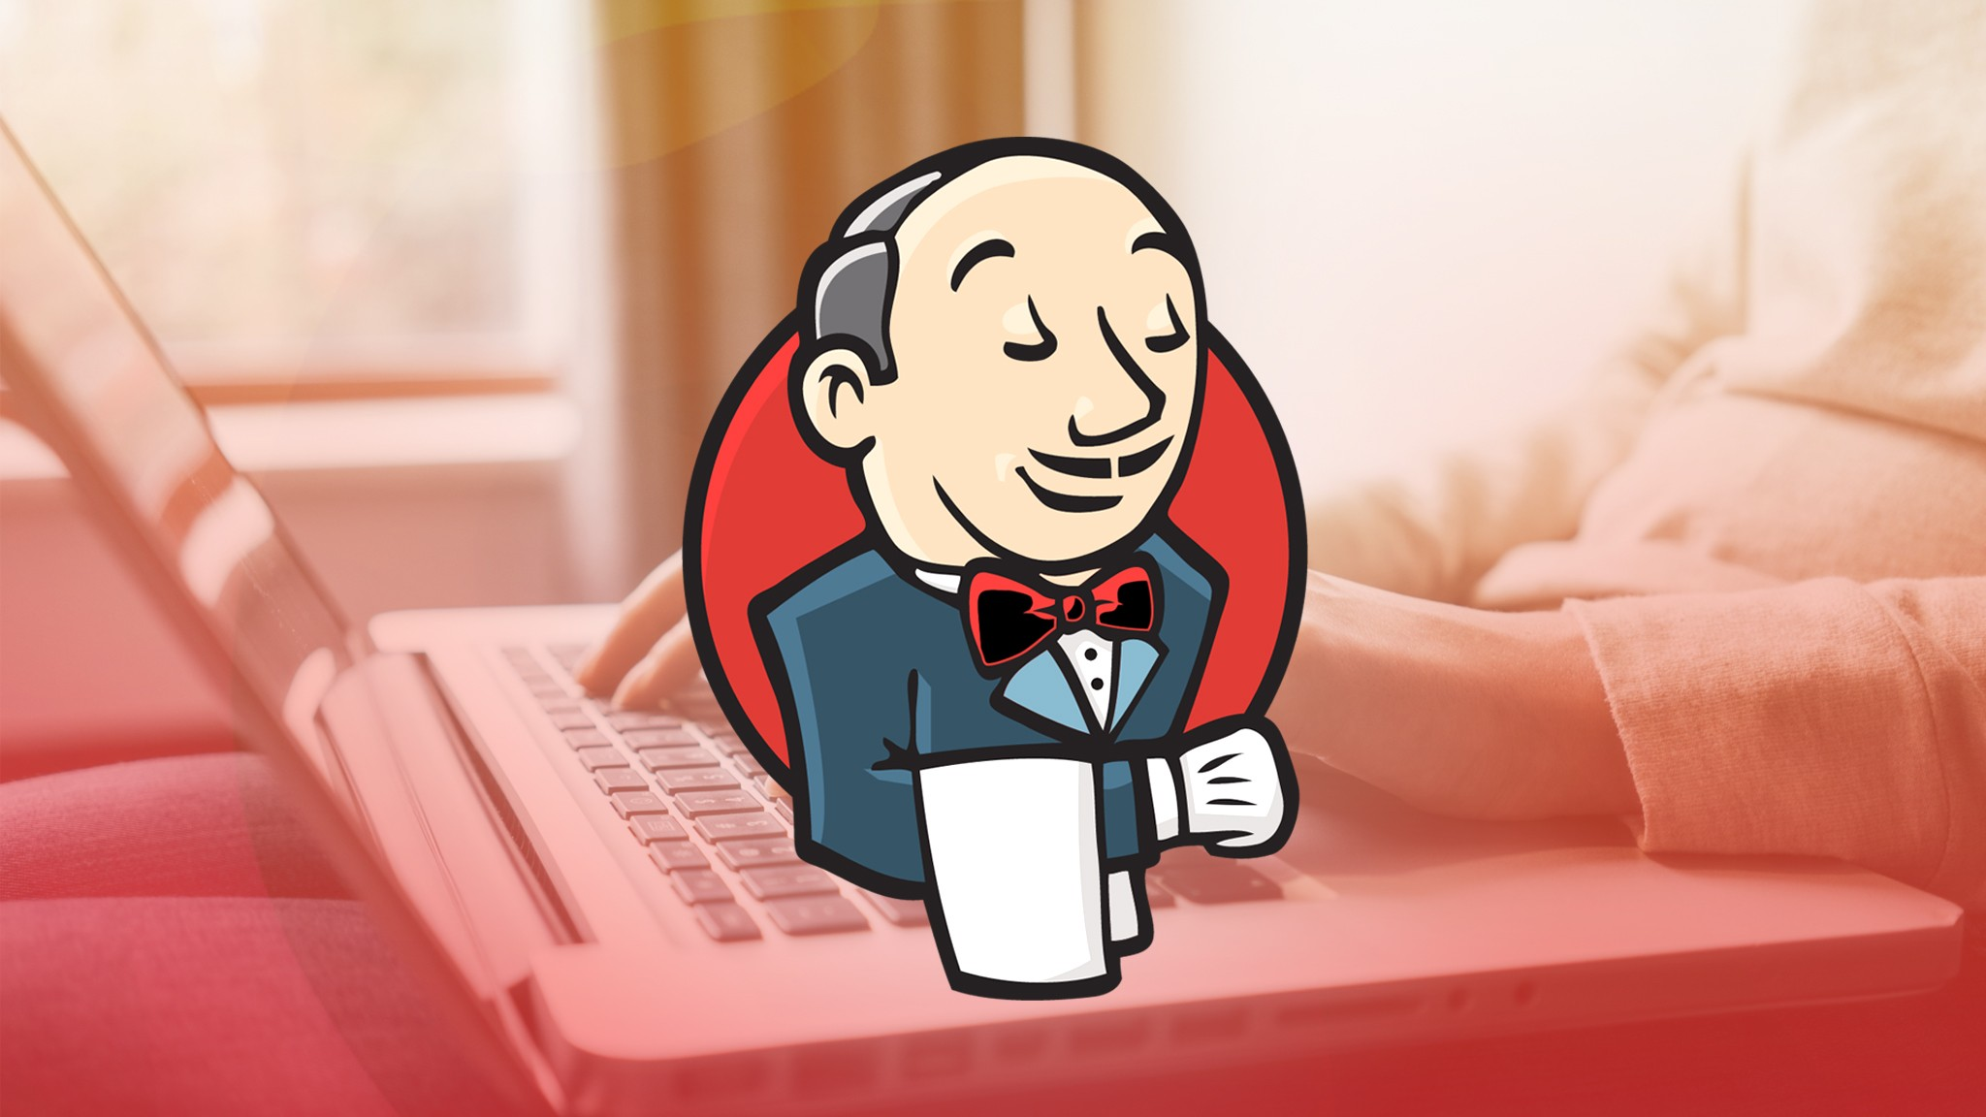
Build Automation tool - Jenkins

Slide 17
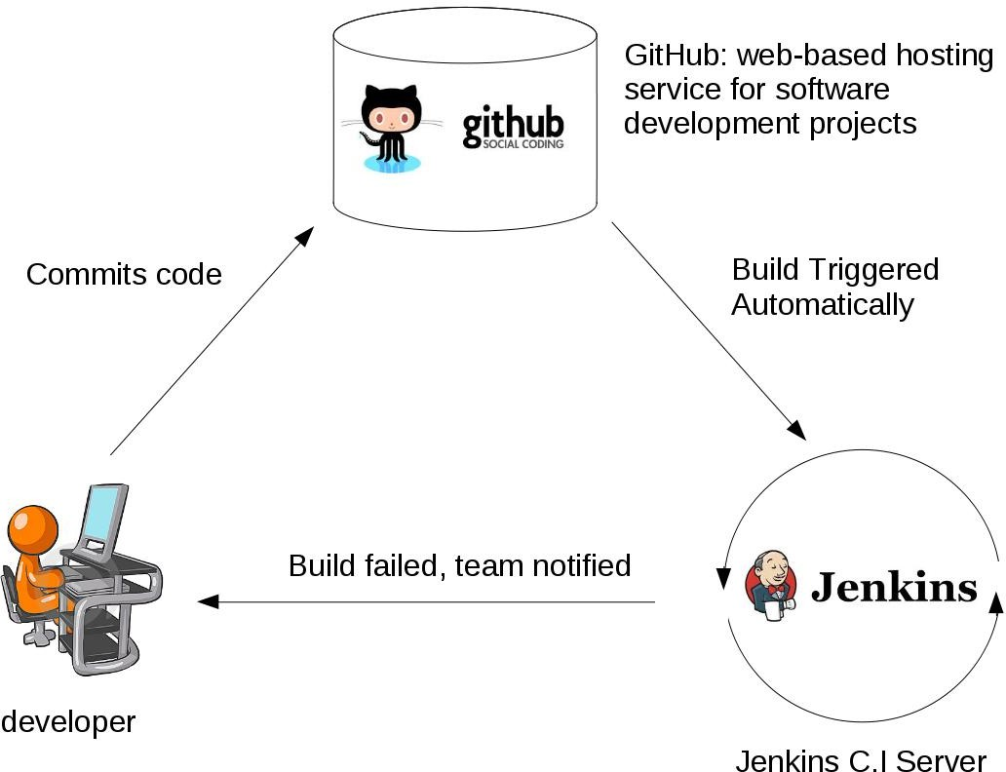
CI/CD using Jenkins
Continuous integration
Continuous delivery

Slide 18

The End @becloudready

